Slide 1





van Deursen A
van Dijk J
Hargittai E
Authors
Van Dijk J; Hacker K (2003) -The Digital Divide As A Complex And Dynamic Phenomenon
Van Dijk J (2006) -Digital Divide Research, Achievements And Shortcomings
Van Deursen A; Van Dijk J (2014) -The Digital Divide Shifts To Differences In Usage
Articles
New Media & Society
Information Society
Information Communication & Society
Journals
Universities
University of Twente
London School of Economics
University of Zurich
United Kingdom
Netherlands
Spain
Countries

Slide 2



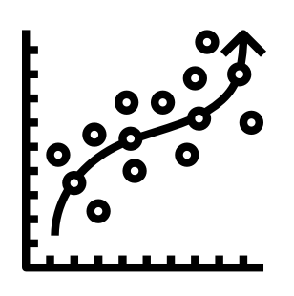

Bibliometric Analysis of European Research on Digital Divide:
An Exploration of the Corporate Landscape
Chapter 1
Chapter 2
Digital Divide in European Enterprises: A Clusterwise Linear Regression Analysis of Digital Technology Usage
Chapter 3
Digital Technologies and Innovation in Europe: A Sectoral Analysis Using Panel Data

